Slide 1
The Central Processing Unit (CPU)
Understanding Computers

Slide 2
Learning Objectives
Draw a block diagram of the main components of a computer: input, processor, output and storage.
Name the three stages in the Fetch Execute Cycle
Define Hz, MHz and GHz and state how these relate to the speed of the processor

Slide 3
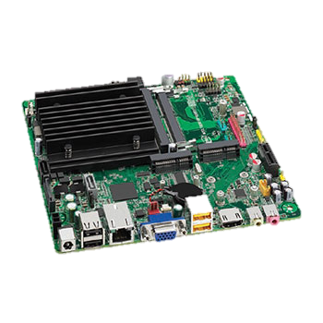
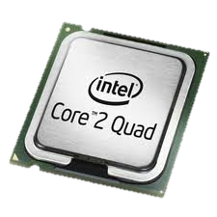
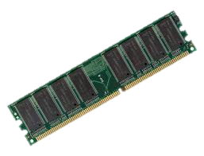
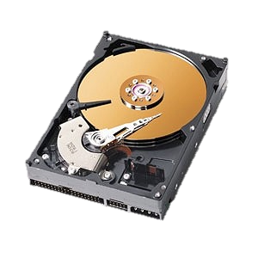
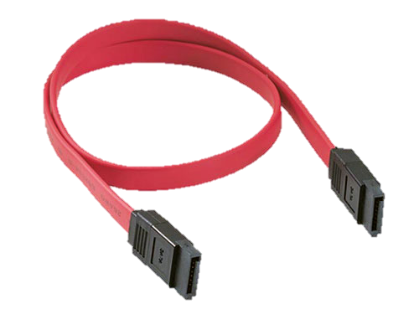
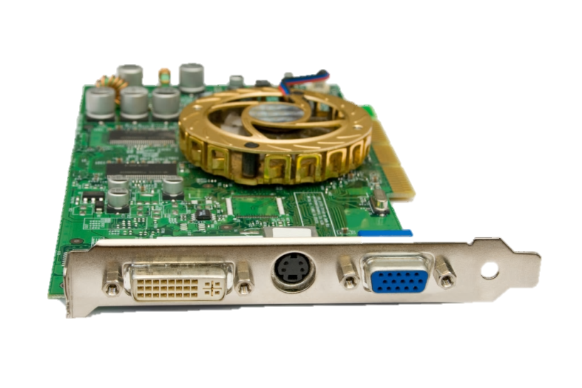
What are these Components?

Slide 4
The Components of a Computer
Central Processing Unit
(CPU)
Input
Storage
Main Memory
Output

Slide 5
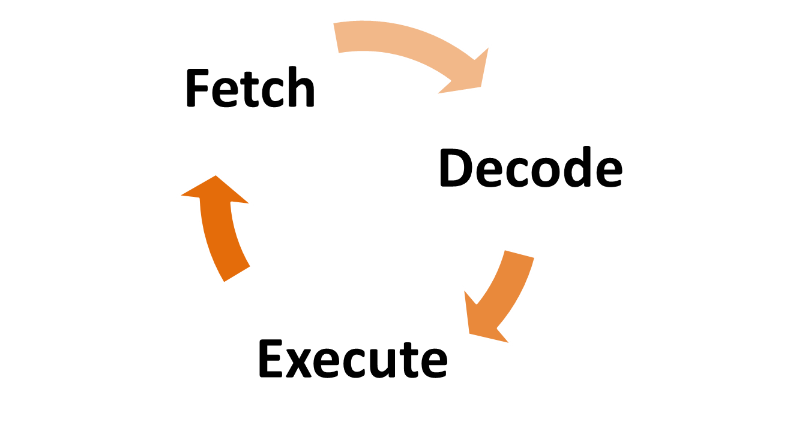
Fetch – Decode – Execute Cycle

Slide 6
Fetch – Decode – Execute Cycle
Computer has a list of instructions in memory to carry out.
CPU Fetches top instruction from the list
Instructions is passed to Decoder to interpret
Decoder passes on the instruction
Instruction is Executed or carried out
CPU Fetches top instruction from the list…

Slide 7
Activity
Pupil 1 – holds instructions in the order they are to be processed
Pupil 2 – fetches instruction and gives to Pupil 3
Pupil 3 – decodes instruction and tells Pupil 4 what to do
Pupil 4 – executes the instruction

Slide 8
Processor Speed
One cycle per second = 1 Hertz (Hz) = 1 instruction carried out each second
1 Kilohertz (KHz) = 1024 cycles per second
1 Megahertz (MHz) = 1,048,576 cycles per second
1 Gigahertz (GHz) = 1,073,741,824 cycles per second (Approximately 1 Billion!)
How fast is your computer’s processor?

Slide 9
RAM vs ROM
RAM stands for Random Access Memory
ROM stands for Read Only Memory
Some data needs to be permanently held in memory, even when the machine is switched off
What does a computer do when you turn it on?
Where are these instructions held?

Slide 10
Plenary
What is memory?
What is the difference between a hard disk and memory?
What is a processor?

