Slide 1
Understanding Binary
Understanding Computers

Slide 2
Learning Objectives
Understand why all data is represented in binary in a computer
Define a Bit, Byte, Kb, Mb and Gb
Convert integers to binary numbers
Convert binary numbers to integers
Show how characters can be represented using ASCII

Slide 3
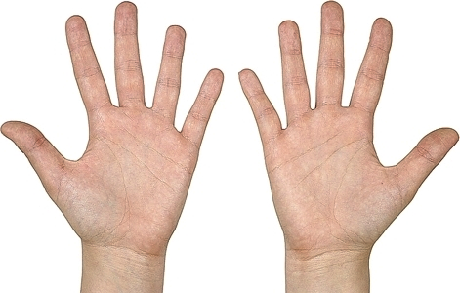
Decimal Number System
(Sometimes called the Denary system)
Why 10 digits?

Slide 4
What about Computers?
Computer use millions of electronic circuits and switches which can either be On or Off
On is represented by 1 and Off is represented by 0

Slide 5
Binary – On & Off
The standard On / Off symbol on a switch is a 1 and a 0:

Slide 6
Bits and Bytes
0 or a 1 = 1 Bit (Binary Digit)
8 Bits = 1 Byte
1024 Bytes = 1 Kilobyte (Kb)
1024 Kb = 1 Megabyte (Mb)
1024 Mb = 1 Gigabyte (Gb)
1 Byte = 1 Character of text
How many Gb in a Terabyte?
How many bytes in a Megabyte?

Slide 7
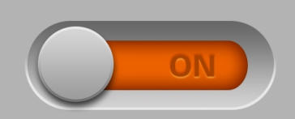

Binary representation
One switch can only represent 2 possible states
  On or Off.
Two switches can represent 4 states
  On & On
  On & Off
  Off & On
  Off & Off
1
2
1
2
3
4

Slide 8
Binary representation
Number of Switches | Possible combinations or states
1 | 2
2 | 4
3
4
5
6
7
8

Slide 9

Binary to Denary Conversion
128
64
32
16
8
4
2
1
0
1
0
1
0
0
0
1
=
64
+
16
+
1
=
81

Slide 10
How our Decimal Number System Works
100
10
1
5
8
3
The number 583 represents five 100s + eight 10s + three 1s. 500 + 80 + 3.
As we move from right to left, each digit is worth ten times the previous one.

Slide 11
The Binary System
4
2
1
1
0
1
In Binary, there are only two digits, 0 and 1. As we move from right to left, each digit is worth twice as much as the previous one.

Slide 12
Binary to Decimal Conversion
Decimal | Binary
0
1
2
3
4
5
6
7
8
9
10
Work out the Binary numbers from 0 to 10

Slide 13
Decimal to Binary
Convert 28 to Binary
Method
  Working right to left write out the numbers 1, 2, 4, 8 and so on doubling each time to 128.
  28 has a 16 in it, leaving 12. 12 is 8 + 4.
128 | 64 | 32 | 16 | 8 | 4 | 2 | 1
0 | 0 | 0 | 1 | 1 | 1 | 0 | 0

Slide 14
Activity
Use Worksheet 7-4 to convert binary numbers to and from decimal numbers

Slide 15
Representing Characters
How are characters represented in Binary?
How many characters are there on your keyboard?
How many bits would be needed to represent up to 128 characters?

Slide 16
ASCII
American Standard Code for Information Interchange
Numerous different codes for representing data have been invented, but ASCII is used nowadays on nearly all computers.
Originally only 7 bits were used but now the eighth bit is used to give extra characters such as ©, ® etc
How many different characters can be encoded using seven bits? Eight bits?

Slide 17
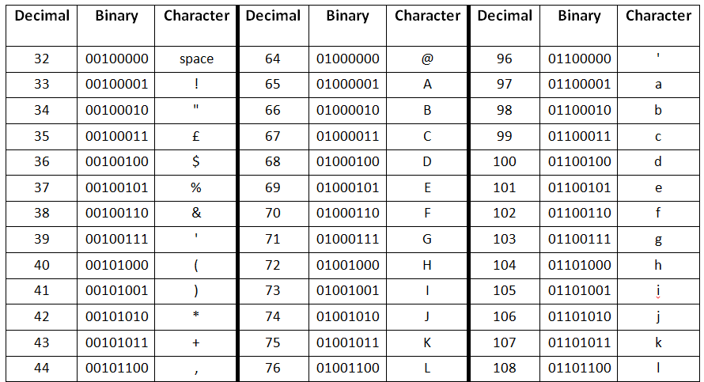
ASCII Table

Slide 18
ASCII
It is a character-encoding scheme originally based on the English alphabet.
ASCII codes represent text in computers, communications equipment, and other devices that use text.
For example: small letter ‘f’ is represented by the following combination of bits in the ASCII table.
  f = 1100110 or in 8 Bits, 01100110
8 bits is called a Byte.

Slide 19
Numbers in ASCII
Numbers as well as letters and other symbols are represented in ASCII
What is the bit pattern for the character 5 in ASCII?
What is the bit pattern in binary for the number 5?
When 5 is pressed on the keyboard, the ASCII bit pattern is sent to the computer. It can’t be used for arithmetic!

Slide 20
Challenges
Challenge 1: Use the ASCII table on the ASCII Worksheet to write down the binary equivalent of your first name.
Challenge 2: Write a brief coded message for someone in binary using the ASCII Code sheet.

