Slide 1
1) Introduction to Flowchart Diagram and Pseudo Code

Slide 2
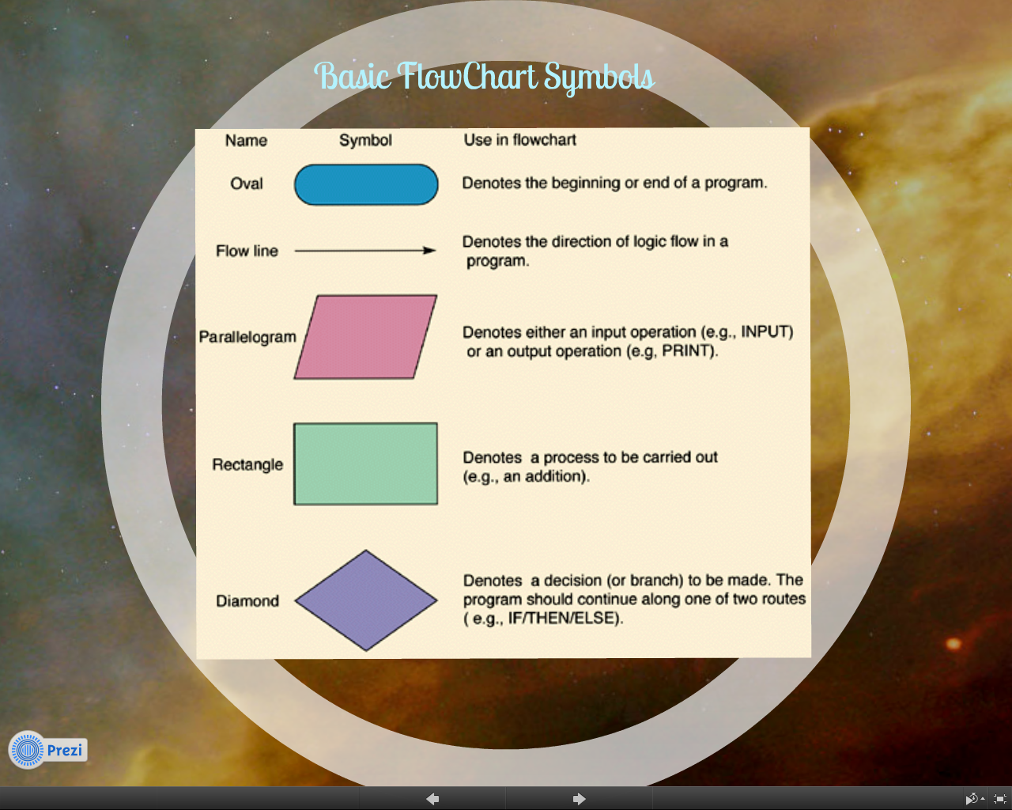
Flowchart Symbols
Do Starter Activity 1 in your Booklets

Slide 3
Lesson Objectives (lesson 1)
Level 2 – be aware of the use of Flowchart Symbols
Level 3 – use logical reasoning to predict the behaviour of simple programs
Level 4 – present simple algorithms diagrammatically
Level 5 – partially decompose a problem into its sub-problems and make use of a notation to represent it.
Level 6 –describe systems and their components using diagrams.
Level 7 - use and evaluation of computational abstractions that model the state and behaviour of real-world problems and physical systems

Slide 4
Tools to help us to program
Flowcharts - Graphical and verbal illustrations of algorithms. Useful in describing any step-by-step procedure and making it easier to create programming code
Pseudo code - Flow chart in a text form. More like a computer program, but with human language therefore it can be easily translated into computer languages.
Algorithms - Sequence of step-by-step instructions that will produce a solution to a problem – for this term we will not be playing around with Algorithm exercises
Question (a)
Complete the sentences in the booklet with the missing words

Slide 5
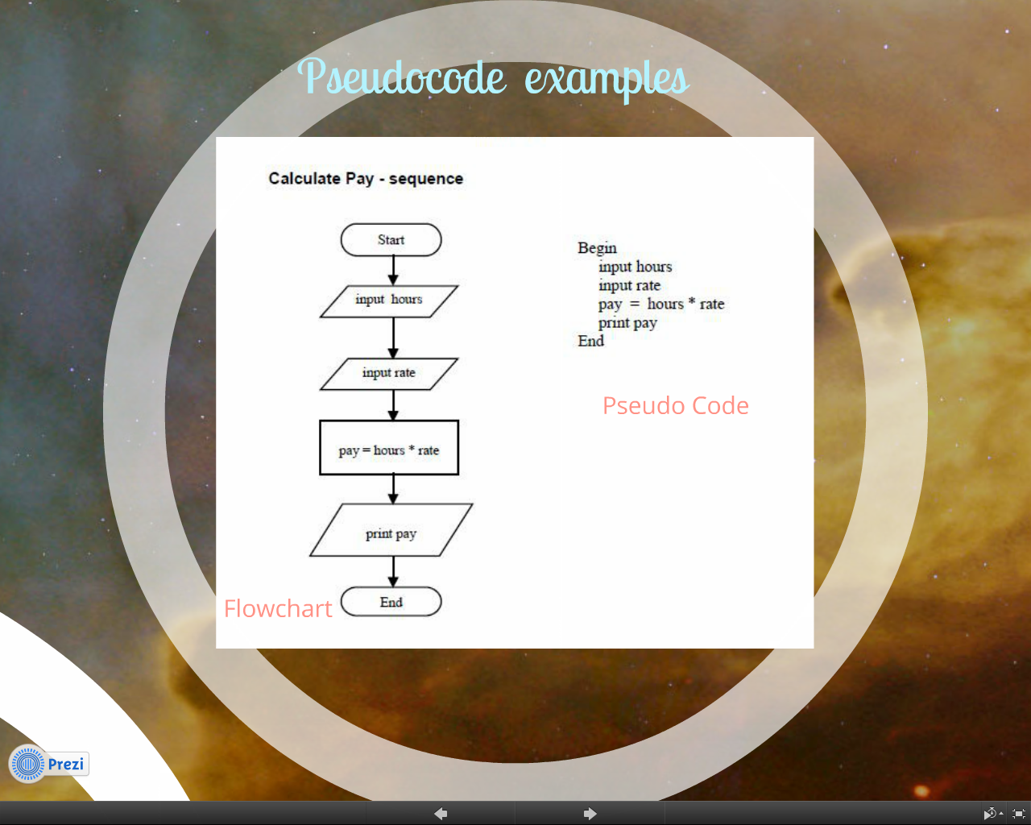
Question (b)
What is the flowchart diagram and Pseudo Code both showing?

Slide 6
Question ( c ) and (d)
Create a flowchart diagram and pseudo code which will allow the user to enter the state of two switches (either 1 (on) or 0 (off)).
It should work out if both switches are on and then output the message 'the light is on'. Otherwise, the output message will be 'the light is off'.
Steps
Think about what is needed to interact with the user
Create a flow chart.
Create PseudoCode for the program

Slide 7
Question ( e )
Create a flowchart for the following pseudo code:
If student's grade is greater than or equal to 60
Print "passed"
else
Print "failed"

Slide 8
start
Question ( f )
Create pseudo code for the following flowchart :
Input M1, M2,
M3, M4
Grade =
(M1 + M2 + M3 + M4)/4
Is Grade < 50
YES
NO
Print "passed"
Print “failed"
stop

