Slide 1

Embedded Systems

Slide 2

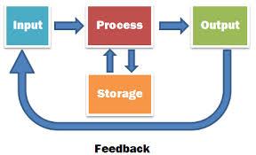
What Is A Computer System?
Learning Objectives
Understand what are embedded systems
Learning Outcomes
A/A* Describe the use and give examples of embedded system
C/B Explain how an embedded system differs from a non-embedded system.
E/D List embedded systems in the home.
An input is processed to give an output
A computer system is a collection of hardware and software that work together to achieve a data processing task.

Slide 3
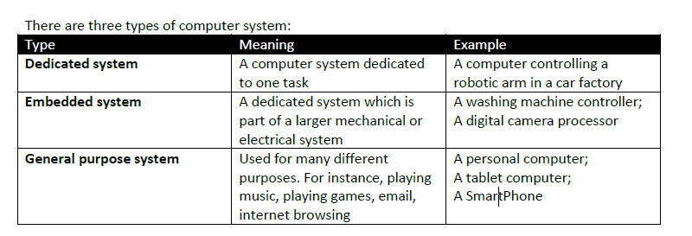
Types Of Computer Systems
Learning Objectives
Understand what are embedded systems
Learning Outcomes
A/A* Describe the use and give examples of embedded system
C/B Explain how an embedded system differs from a non-embedded system.
E/D List embedded systems in the home
.

Slide 4
Types Of Computer Systems
Learning Objectives
Understand what are embedded systems
Learning Outcomes
A/A* Describe the use and give examples of embedded system
C/B Explain how an embedded system differs from a non-embedded system.
E/D List embedded systems in the home
PCs, smartphones and games consoles are typical, everyday computers but there are many other types of computer systems.
Embedded computers
Embedded computers are used in car engines, spacecraft and MP3players. They are dedicated systems that are designed for a fixed purpose. This is different to the type of system in PCs and smartphones, which use software for a range of purposes.
Wearable technology
Wearable technology describes clothing that makes use of electronics and computers.

Slide 5
What is an embedded system
Learning Objectives
Understand what are embedded systems
Learning Outcomes
A/A* Describe the use and give examples of embedded system
C/B Explain how an embedded system differs from a non-embedded system.
E/D List embedded systems in the home
An embedded computer is a single chip that contains all of the elements that are essential for any computer i.e.
RAM ROM CPU
Input Output Clock
Another term often used for an embedded computer is a 'micro controller'. This is because the main purpose of an embedded computer is to control something.
All of the following also contain an embedded computer:
Telephones
Televisions
Cameras
Washing machines
Microwave cookers
Dishwashers
Cars
Notes:
Airport control centre
Hospitals
Ecommerce
Car manufactoring

Slide 6

Embedded sytems
Learning Objectives
Understand what are embedded systems
Learning Outcomes
A/A* Describe the use and give examples of embedded system
C/B Explain how an embedded system differs from a non-embedded system.
E/D List embedded systems in the home
Write the learning objectives (underlined)
Todays date
List at least 5 embedded systems you can find in your home
Explain how an embedded system differs from a non embedded system. Give an example of non embedded system

Slide 7
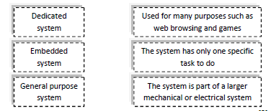
Embedded systems
Learning Objectives
Understand what are embedded systems
Learning Outcomes
A/A* Describe the use and give examples of embedded system
C/B Explain how an embedded system differs from a non-embedded system.
E/D List embedded systems in the home
Activity 2
1. Computer systems have three components: Processing, outputs and inputs.
Draw a diagram with these elements in the correct form
2. Draw the boxes below and match the types of systems to the definitions

Slide 8
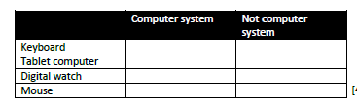
Assessment Activity
Learning Objectives
Understand what are embedded systems
Learning Outcomes
A/A* Describe the use and give examples of embedded system
C/B Explain how an embedded system differs from a non-embedded system.
E/D List embedded systems in the home
3. Draw the table below and tick the correct box

Slide 9
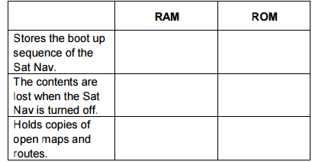
Assessment Activity
Learning Objectives
Understand what are embedded systems
Learning Outcomes
A/A* Describe the use and give examples of embedded system
C/B Explain how an embedded system differs from a non-embedded system.
E/D List embedded systems in the home
4. Gareth has a satellite navigation system (Sat Nav) in his car that uses RAM and ROM. Draw the table below and tick one box in each row to show which statement is true
5. Gareth’s Sat Nav contains an embedded system. Define what is meant by an ‘embedded system’.

Slide 10
Command verbs
Learning Objectives
Understand the fundamentals of computer systems
Learning Outcomes
A/A*Explain the need for reliability in computer systems
C/B Describe importance of computer systems in the modern world
E/D Define a computer system
Word | Meaning
Advantage /Disadvantage | Benefits and drawbacks Pros and cons Good points and bad points
Describe | This is more than one sentence with an expansion or example- what/ how/ or why something happens; You must use correct technical terminology For example Q Describe a computer network A network is more than one computer, sharing one connection. They are able to access each other's files and use the same internet connection.
Define | State or describe the nature, scope or meaning. 1 sentence For example A chair is a seat with a back, for one person.

