Slide 1
Storage Devices
Understanding Computers

Slide 2
Learning Objectives
State the typical capacities, strengths and weaknesses of different storage devices
Describe how data is stored on a CD
Describe how 0s and 1s are represented by pits and lands on a CD
Name three types of optical storage device

Slide 3
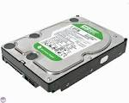
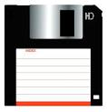
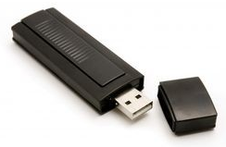

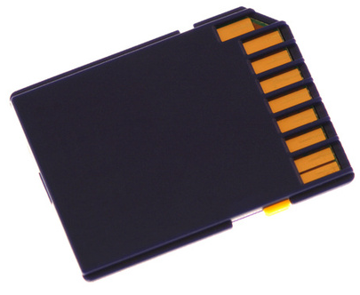
Starter Activity

Slide 4
Data Units
Name Equal to Size in Bytes
Bit 1 bit 1/8
Byte 8 bits 1
Kilobyte 1,024 bytes 1,024
Megabyte 1,024 kilobytes 1,048,576
Gigabyte 1,024 megabytes 1,073,741,824
Terrabyte 1,024 gigabytes 1,099,511,627,776

Slide 5
Storage Units
Name What can it store?
Byte A single letter, like "A."
Kilobyte A 14-line e-mail. A pretty lengthy paragraph of text.
Megabyte A good sized novel.
Gigabyte Roughly 300 MP3s or 40 minutes of video at DVD quality. A CD holds about three quarters of a gigabyte.
Terrabyte 1,000 copies of the Encyclopedia Britannica. Statistically, the average person has spoken about this much by age 25!

Slide 6
Optical Media
CDs, DVDs, Blu Ray Disks
Some are read only
Some you can burn new data onto
Some you can re-use over and over again with new data

Slide 7
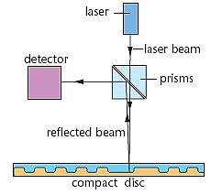
Reading and Writing to a CD-ROM
Powerful laser ‘burns’ disk surface
Laser ‘burns’ pits into surface
Weak laser reads surface
Detector measures reflected light

Slide 8
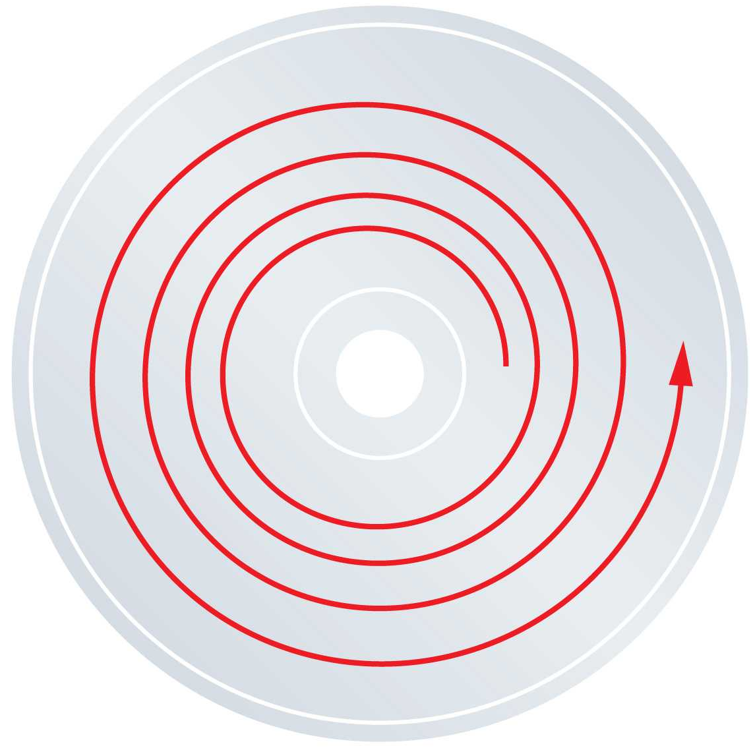
Tracks on a CD
A CD has one long track on it full of Pits and Lands.
This tracks begins at the centre of the disk and work outwards in a tight spiral.

Slide 9
‘Burning’ a CD-ROM
Pits and Lands are used to represent 1s and 0s in Binary.
Lasers shine light at the surface and light is reflected from the silver surface of the disk – except where a Pit begins or ends. Here the reflection is scattered and a 1 is read
  Good reflection / Poor reflection
  On / Off
  1 / 0
A pattern of 1s and 0s can make a word using ASCII, therefore you can store a word using a series of Pits and Lands ‘burnt’ into the disk.

Slide 10
Pits and lands
All Optical media (CD, DVD, Blu-Ray etc.) have pits and lands
These are microscopic and represent the binary information of the data stored on the disc
A CD is reflective and reflects the laser into a sensor to register it as a 0, but when the light hits the beginning or end of a pit, it scatters with little reflection, and a 1 is registered

Slide 11
How a CD-ROM is read
Top of CD ROM Disk
Change
Change
Change
Pit
Land
Land
Pit
Land
Bottom of CD ROM Disk
Data is encoded onto the CD using a series of ‘Pits' and ‘Lands‘.
A change from a Pit to a Land is read as a 1 and no change or a Land is read as a 0.
In this figure, it will read as: 01001010
Remember Your ASCII!
Therefore 01001010 = 74 = Letter J
8 Bits = 1 Byte = 1 Character of Text
Reflected Light
Light Sensor
Laser

Slide 12
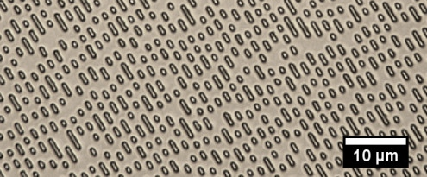
The Surface of a CD-ROM
Microscopic view of the surface of a CD ROM.

Slide 13
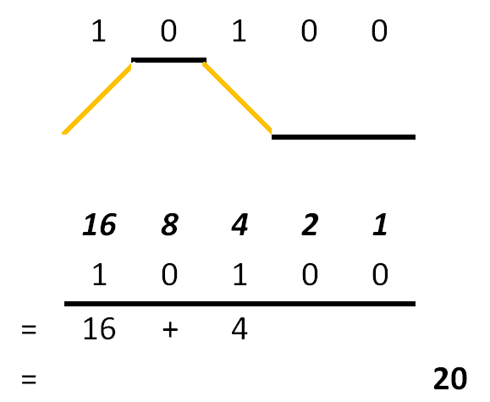
Activity
Complete Worksheet 7-8 Reading from a CD.
Use Worksheet 7-5 ASCII Codes sheet to help you convert your readings into text.

Slide 14
Recap
Name at least three types of Optical storage device.
How is data written to a CD?
How are zeros and one represented on a CD?
How might a Hard Disk store data?

