Slide 1

Activity 1
Review the work from last lesson so that you can explain the following:
What is the purpose of a CPU.
What steps does the CPU take to process data.

Slide 2
The CPU
Mastering understanding of how data flows within the central processing unit (CPU) as instructions are executed.

Slide 3
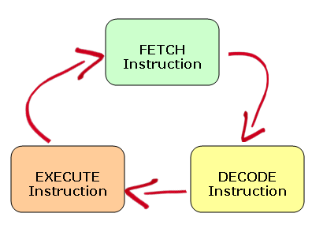
The CPU – Central Processing Unit
Learning Objectives:
Understand how data flows within the central processing unit (CPU) as instructions are executed
Outcomes
C/B describe in own words the journey of data through the CPU including the function ALU
D/E Describe in own words the fetch execute cycle.
F/G Can draw fetch execute cycle and demonstrates some understanding of journey of process
Review from Last Lesson (1)
The CPU follows three steps in order to process data:
It is known as the Fetch - Decode - Execute cycle (aka Fetch-Execute Cycle).
1) Fetch Data from Primary Storage (Main Memory / Ram)
3) Process the Data (perform calculations or logic comparisons)
2) Make Sense of the Data

Slide 4

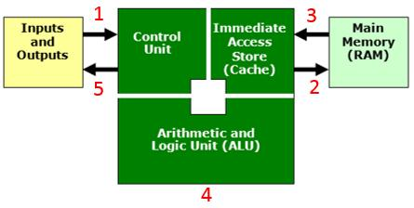
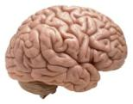

The CPU – Central Processing Unit
Review from Last Lesson (2)
The three main parts of the CPU responsible for the F-D-E cycle are the:
Control Unit
Immediate Access Store (IAS)
Arithmetic and Logic Unit (ALU)
An input device (e.g. keyboard) sends data to the CPU. The Control Unit receives this data.
The Control Unit sends this data into main memory to be used later.
When the time is right, the data will be transferred from main memory into cache (IAS)
The data will then be sent to the ALU for processing
The control unit will send the processed data back (for example to an output device such as a screen or monitor).

Slide 5
The CPU – Central Processing Unit
Clock Speed
The speed of the Fetch-Decode-Execute cycle is determined by the CPU’s clock chip.
This chip uses a vibrating crystal that maintains a constant rate.
The speed of the clock is measured in hertz (Hz) which is the amount of cycles per second.
A clock speed of 500Hz means 500 cycles per second.
Current computers have CPU clock speeds of 3GHz which means 3 Billion cycles per second.

Slide 6
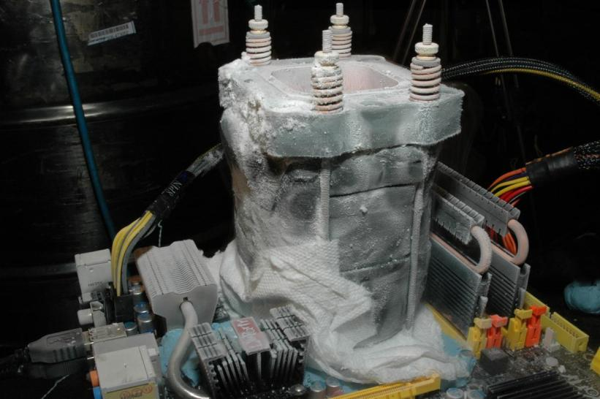
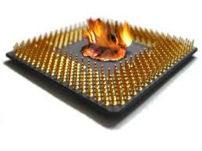
Overclocking
It is possible to increase the clock speed for a CPU.
This is known as overclocking.
In theory, if the clock is faster then the CPU can perform more calculations and perform faster.
Problem is that CPUs get hot the more work they do – so overclocking is dangerous without the appropriate heat management.

Slide 7
Primary and Secondary Storage
Primary and Secondary Storage
A computer system will have two types of storage:
Primary – Cache, RAM (aka main memory), ROM
Secondary – Hard Disk, Flash Drive
They differ in a number of ways:
Primary Storage | Secondary Storage
Most Primary Storage is volatile (temporary). | All secondary storage is (non-volatile) permanent
Primary Storage is expensive and smaller. | Secondary storage is usually cheaper and large
Primary storage is smaller in capacity (L2 Cache is only 2MB) | Secondary Storage is bigger in capacity
Primary storage is closer to the CPU and/or is integrated onto it and therefore is faster. | Secondary storage connects to the CPU via cables and therefore is slower

Slide 8
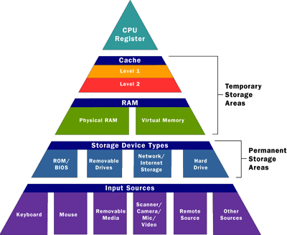
Speeds of data transfer of different devices
Faster
Slower

Slide 9
The CPU – Central Processing Unit
The Cache
As we have just seen CPUs can work very quickly indeed but unfortunately CPUs can only work when supplied with data. The RAM (that supplies the data) cannot work at the same speed.
To overcome this the CPU’s cache memory will not just copy the instruction needed at that time, instead it will also copy the continuing instructions.
Cache memory has read speeds similar to the CPU and is therefore much faster than RAM.
So, to improve efficiency the CPU’s ‘Control Unit’ will look first in the cache for the next instruction to see if it has already been copied which reduces the time taken to access data.
If the cache is larger, it is more likely that the next required instruction has already been transferred from the RAM to the CPU thus improving process time.
2
1. If data not in cache, request from RAM
2. Data (and future data) copied to cache for quicker access
1

Slide 10
Cache
2
1
1. If the required data is not in the cache, the control unit will request it from RAM
2. Data/Instructions (and future instructions) copied to cache for quicker access

Slide 11
The CPU – Central Processing Unit
CPU Cores
CPUs of today are pretty much at the limit of today’s technology.
So if CPUs can’t go faster, the solution its to add 2 CPU chips, or 4, or 8, etc).
These chips are called ‘cores’.
Because the various cores can each carry out their own Fetch – Decode – Execute cycle it means that instructions can be processed at the same time. Allowing a CPU to process MORE data during the same time period.
Dual Core processors have 2 CPU cores.
Quad Core CPUs have 4 cores.

Slide 12
Exam Practice
In a short while you will carry out some exam practice.
But first…
…Some exam technique tips.

Slide 13
Command Words
What do each of these words mean?
State/Identify/Give/Name
Describe
Describe/Explain/Discuss using examples
Explain
Discuss
…you need to know because they appear in all exams. If (for example) the examiner asks you to EXPLAIN and you instead just DESCRIBE, you will not get any marks.

Slide 14
Command Words
State/Identify/Give/Name
Simply label a diagram, fill out a table or write a few words
Describe
Describing is ‘saying what you see’
E.G.: A computer will have a CPU, Primary and Secondary storage etc
Explain
Explaining is ‘saying why something is like that’
E.G.: A computer will have a CPU so that it can process all of the data the computer needs to perform a range of tasks. Primary and Secondary storage is needed because…
Discuss
Discussing is ‘looking at two sides of an issue, weighing up the two views and giving a conclusion’. Often these require a mini essay answer.
E.G.: New technology could be seen as being bad for the environment because…, but on the other hand, new technology has lead to… In conclusion I believe that…
Describe/Explain/Discuss using examples
Finally, if you are asked to give examples in any of these types of questions – YOU MUST GIVE EXAMPLES!

Slide 15
Remember
Whenever you answer exam questions you must CaM it!
Look at the…
Command words AND Marks
Do what the question asks and make sure your answers have enough points or explanations to get the marks available.

Slide 16

Activity 2
Complete the timed exam practice questions.
5 minutes

Slide 17
