Slide 1
Elements of a Computer System
Understanding Computers

Slide 2
What is a Computer?

Slide 3
Learning Objectives
Distinguish between hardware and software
Identify Input, Output and Storage devices
Name at least five pieces of software
Suggest appropriate input and output devices for a given scenario

Slide 4
Hardware or Software?
What is Hardware? | What is Software?
Objects that you can touch, like a Music CD. For example: Disks, disk drives, display screens, keyboards, printers, boards, and chips. | You cannot ‘touch’ software. Software refers to the programs that run on a computer, rather like the music playing on a CD. Examples of software: Windows, MS Word, MS Excel, Kodu and Logo.

Slide 5
Input, Output & Storage Devices
What is an output device? | What is an input device? | What is a Storage device?
An output device is a piece of computer hardware used display or output data which has been processed or stored in a computer. Printer, Speaker. | An input device is anything can be used to enter data into a computer. Keyboard, Mouse. | A storage device is used to permanently record or store data. CD, Hard Drive.

Slide 6
Input Output Process
Complete activity 1

Slide 7
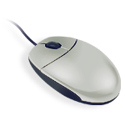
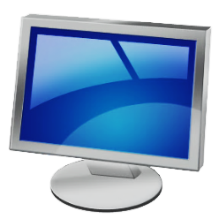
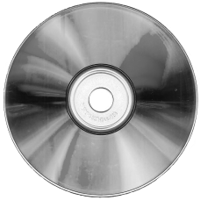
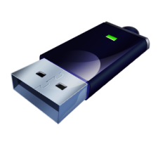
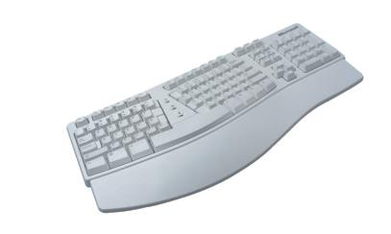
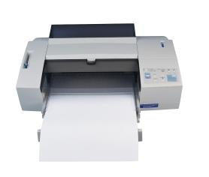
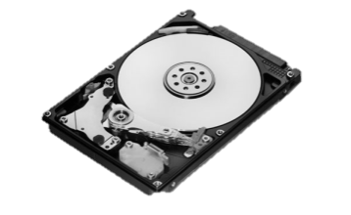
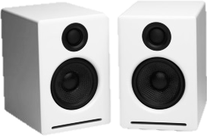
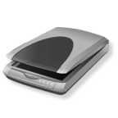
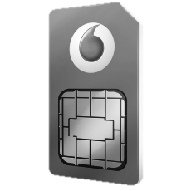

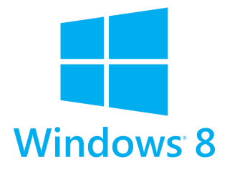
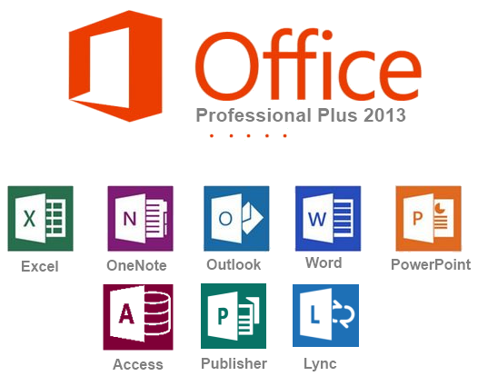
What do each of these images represent? Are they hardware of software? Input, Output or Storage devices?

Slide 8
Computer Systems
Look at Worksheet L2
Determine the input, process and output in each case

